Slide 1
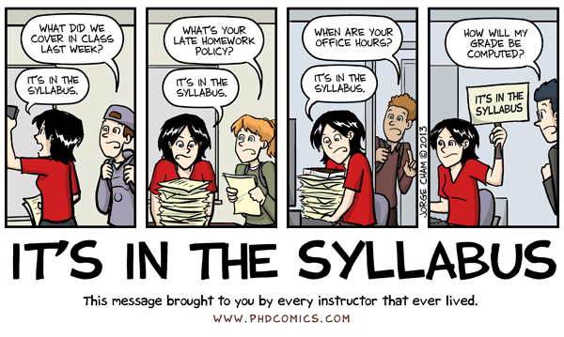
Introduction to General Biology BI 101

Slide 2
General Biology 101
Mrs. Green’s office: HNSC 214
Office hours: Mondays, Tuesdays, Wednesdays 15:00-16:00 on Skype or by appointment
lena.green@umpqua.edu (Canvas email)

Slide 3
Lecture Topics
What is online course?
Online course expectations
What is required for BI 101?
How this course is organized?
Canvas layout and navigation

Slide 4
General Biology 101
Online Course – is designed to be completed online via video-lectures, labs, and online activities. At no time do you have to come to campus.
Semester length is 5 weeks
4 credit course
Lectures delivered by videos on BiologyLessonsOnline.com and laboratory experiments performed at home using a lab kit

Slide 5
Student Expectations
All hybrid class students are expected to login to Canvas learning management system and enter their online lectures during the first week of class. Ideally, students should enter their LMS on the first day of the term.
It is expected that all students are familiar with basic computer skills (basic typing proficiency, online browsing, sending and receiving emails, internet search, use of Microsoft Word, and Canvas). Failure to do so can have a detrimental impact on student performance in the online learning environment.
Activities to engage in include reading the course syllabus, posting to discussion forums, printing study guides, lecture handouts, lab worksheets, review questions, and more.
In order for you to be successful in your studies it is essential that you plan your schedule to include 2-3 hours per week of school work for every credit in which you are enrolled.
Be polite and respectful in your postings on discussion board - practice "Netiquette"

Slide 6
What is Required?
Same textbook all 3 terms
Biology Concepts and Applications by Cecie Starr
older editions OK
Lab Manual (electronic copy is included with your lab kit)
Lab kit can be purchased at the UCC bookstore or buy a redemption code first and then order your kit at eScienceLabs.com
The lab kit has to be purchased
6 – 10 business days in advance

Slide 7
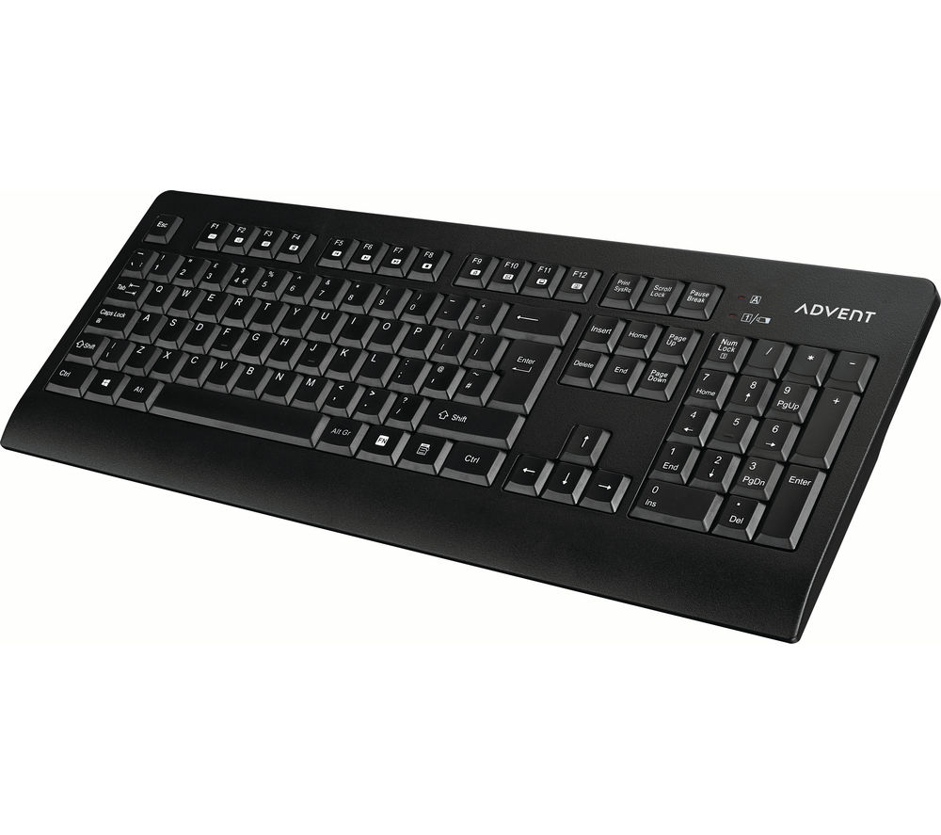
What is Required (cont)?
or
or

Slide 8
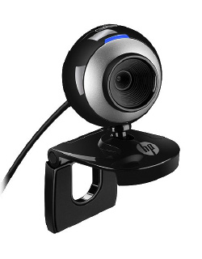
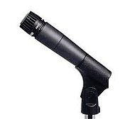
What is Required (cont)?
and
To record yourself (optional)

Slide 9
What is Required (cont)?
or
and

Slide 10
BI 101 Lectures (online)
How This Course is Organized?
Every week we have 6 online video-lectures
Take notes!
Follow your instructor with outlining, coloring, and labeling – it simplifies your study.
Lecture Exams (we have 3 open-book online exams).
Exam points will be based on lectures, labs, reading and the review questions for each chapter.
Missed tests CANNOT be made up
One Comprehensive Final: covers all chapters

Slide 11
BI 101 Labs (at home)
Every week you will be working on 2 labs and 2 online lab quizzes
Use a lab kit to perform the experiments at your home. The lab kit has to be purchased in advance (6 – 10 business days)
There will be 2 cumulative lab tests (50 points each)
Laboratories and lab quizzes are ways to collect easy points in this course.
Notes:
11

Slide 12
Bio 101 Labs
Lab worksheets
available on Canvas in the appropriate folders
Download using a link in the corresponding folder (Microsoft Word document).
Fill it in using lab materials and experiment results.
Include images of experiment results when required
Lab quiz
Take after completing the lab
Open-book quiz
One attempt, 15 min quiz, grades
upload to Canvas gradebook instantly
Lab quizzes will open on Mondays and
close on Sundays at midnight
Notes:
12

Slide 13
Bio 101 Labs
2 cumulative lab tests
Links available on Canvas (week 2 and week 5 pages)
Download using a link on the corresponding page (Microsoft Word document).
Fill it in using lab materials and experiment results.
Submit for grading before the due date
Notes:
13

Slide 14
What if I miss a…
Class
It is your responsibility to keep up with the material. Please make sure you log into Canvas for our online lectures at least 3 days a week
Lecture test
Lecture tests cannot be made up. Special situations will be evaluated case-by-case
Lab
Lab materials are included with the
appropriate pages. Lab experiments
performed at home using a lab kit

Slide 15
Study suggestions
Vocabulary is your foundation
Flashcards
If you don’t know a word, make a flashcard
Lecture slides: understand every little bit
Use your book to understand lecture slides
Review questions for each chapter which will emphasize main points
Students that study constantly
and consistently do best
Get a study buddy

Slide 16
Study suggestions
Step 1: Repetition, Repetition, Repetition
Draw it out-label it!
Write it out
Talk it out-teach it!
Study how you learn best
Active learning helps you learn fastest (handouts in class)
Step 2: TEST YOURSELF
Students having trouble with the material
should meet with me
And go to ESB for tutoring help.
Notes:
16

Slide 17
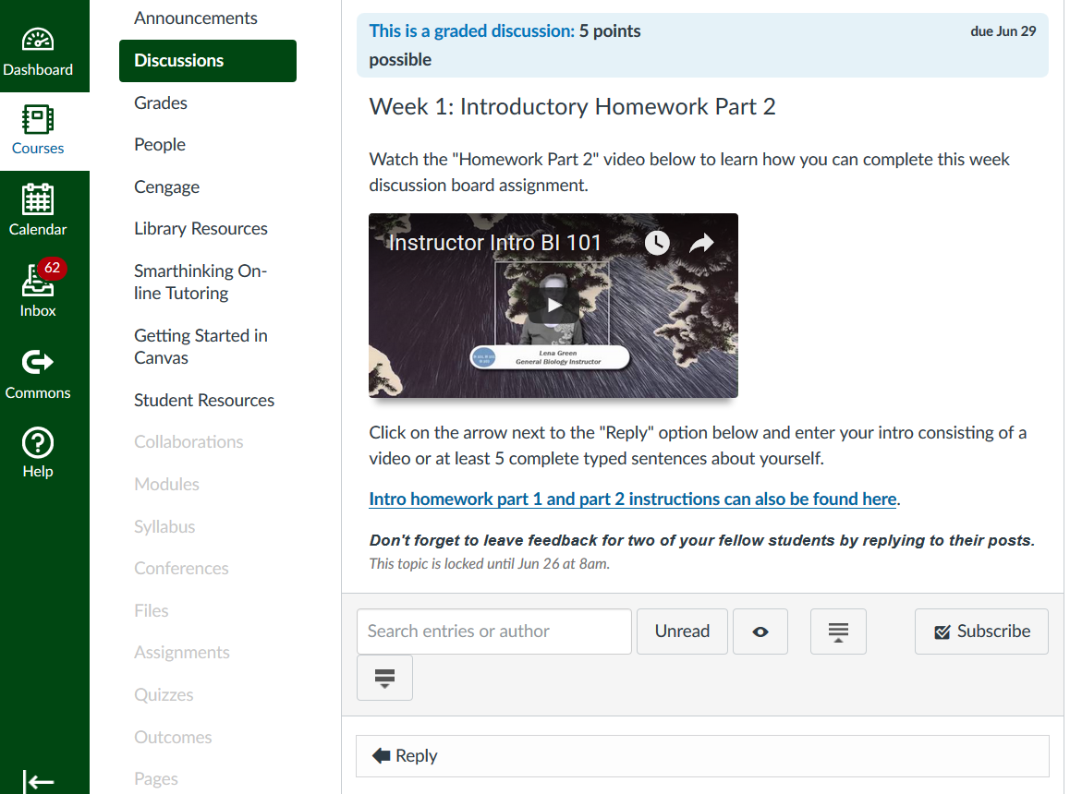
Canvas layout and navigation
Discussion Board

Slide 18
Canvas Orientation
Orientations take place on the first two days of the term. You only need to attend one. Dates and times for this term can be found using this link http://umpqua.edu/ucconline
You may also find additional information about Canvas on our New to Canvas? webpage.
Questions? Contact UCCOnline or
call 541-440-7685.

