Slide 1
microbiology
Chapter 14 ANTIMICROBIAL DRUGS

Slide 2
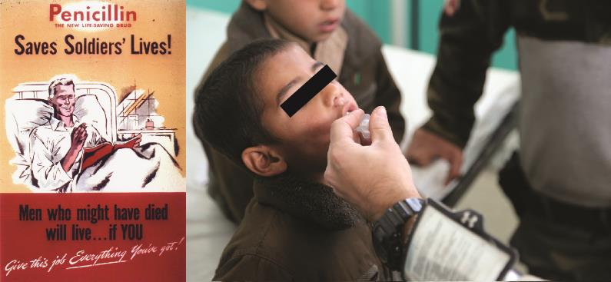
Figure 14.1
First mass produced in the 1940s, penicillin was instrumental in saving millions of lives during World War II and was considered a wonder drug.^{[1]} Today, overprescription of antibiotics (especially for childhood illnesses) has contributed to the evolution of drug-resistant pathogens. (credit left: modification of work by Chemical Heritage Foundation; credit right: modification of work by U.S. Department of Defense)

Slide 3
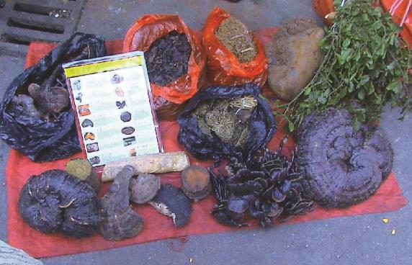
Figure 14.2
For millennia, Chinese herbalists have used many different species of plants for the treatment of a wide variety of human ailments.

Slide 4
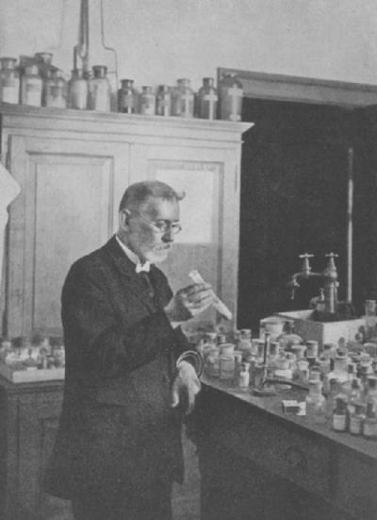
Figure 14.3
Paul Ehrlich was influential in the discovery of Compound 606, an antimicrobial agent that proved to be an effective treatment for syphilis.

Slide 5
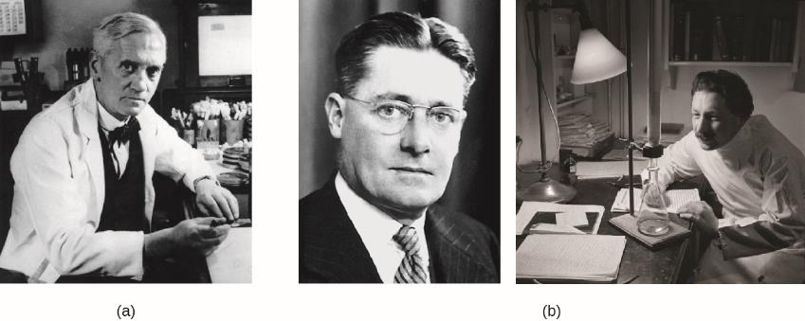
Figure 14.4
Alexander Fleming was the first to discover a naturally produced antimicrobial, penicillin, in 1928.
Howard Florey and Ernst Chain discovered how to scale up penicillin production. Then they figured out how to purify it and showed its efficacy as an antimicrobial in animal and human trials in the early 1940s.

Slide 6
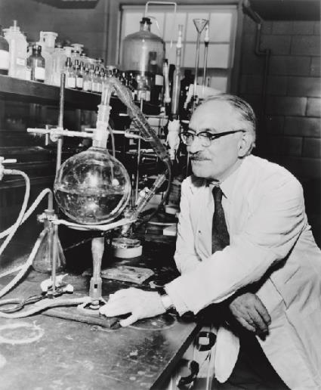
Figure 14.5
Selman Waksman was the first to show the vast antimicrobial production capabilities of a group of soil bacteria, the actinomycetes.

Slide 7
Figure 14.6
Broad-spectrum antimicrobial use may lead to the development of a superinfection. (credit: modification of work by Centers for Disease Control and Prevention)

Slide 8
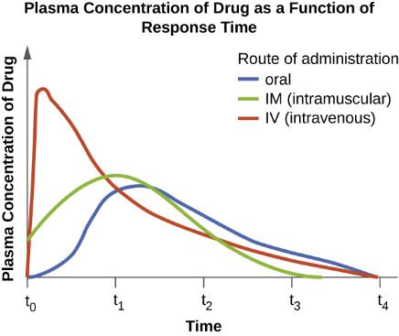
Figure 14.7
On this graph, t₀ represents the time at which a drug dose is administered. The curves illustrate how plasma concentration of the drug changes over specific intervals of time (t₁ through t₄). As the graph shows, when a drug is administered intravenously, the concentration peaks very quickly and then gradually decreases. When drugs are administered orally or intramuscularly, it takes longer for the concentration to reach its peak.

Slide 9
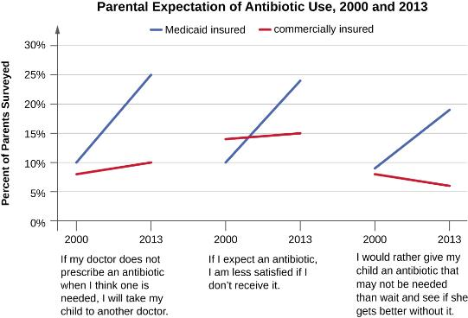
Figure 14.8
This graph indicates trends in parental expectations related to prescription of antibiotics based on a recent study.^{[11]} Among parents of Medicaid-insured children, there was a clear upward trend in parental expectations for prescription antibiotics. Expectations were relatively stable (and lesser) among parents whose children were commercially insured, suggesting that these parents were somewhat better informed than those with Medicaid-insured children.

Slide 10
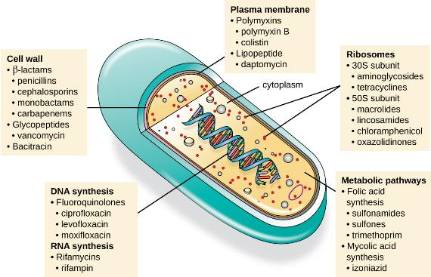
Figure 14.9
There are several classes of antibacterial compounds that are typically classified based on their bacterial target.

Slide 11
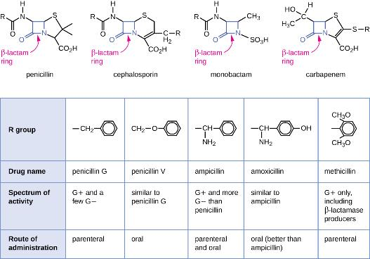
Figure 14.10
Penicillins, cephalosporins, monobactams, and carbapenems all contain a β-lactam ring, the site of attack by inactivating β-lactamase enzymes. Although they all share the same nucleus, various penicillins differ from each other in the structure of their R groups. Chemical changes to the R groups provided increased spectrum of activity, acid stability, and resistance to β-lactamase degradation.

Slide 12
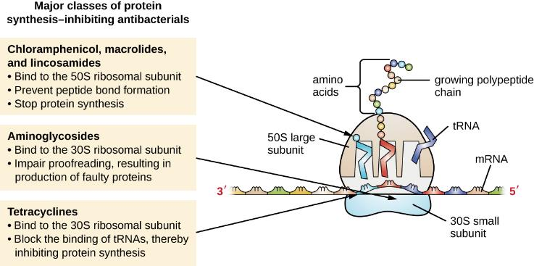
Figure 14.11
The major classes of protein synthesis inhibitors target the 30S or 50S subunits of cytoplasmic ribosomes.

Slide 13
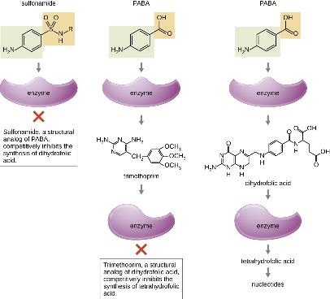
Figure 14.12
Sulfonamides and trimethoprim are examples of antimetabolites that interfere in the bacterial synthesis of folic acid by blocking purine and pyrimidine biosynthesis, thus inhibiting bacterial growth.

Slide 14
Figure 14.13
The predominant sterol found in human cells is cholesterol, whereas the predominant sterol found in fungi is ergosterol, making ergosterol a good target for antifungal drug development.

Slide 15
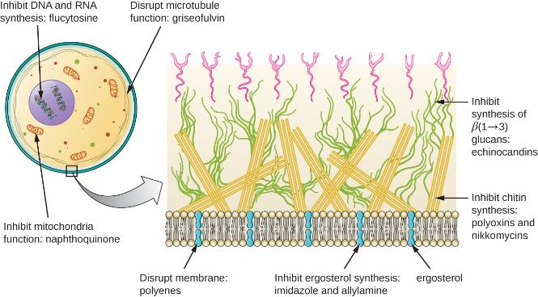
Figure 14.14
Antifungal drugs target several different cell structures. (credit right: modification of work by “Maya and Rike”/Wikimedia Commons)

Slide 16
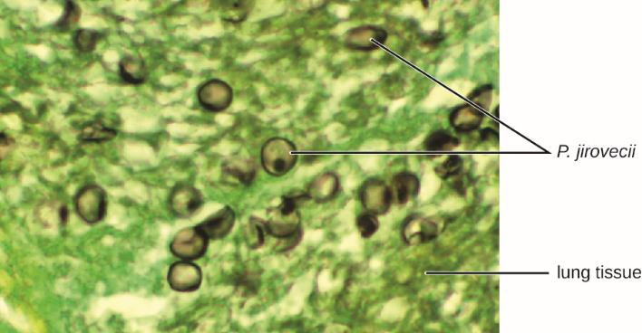
Figure 14.15
Microscopic examination of an induced sputum sample or bronchoaveolar lavage sample typically reveals the organism, as shown here. (credit: modification of work by the Centers for Disease Control and Prevention)

Slide 17
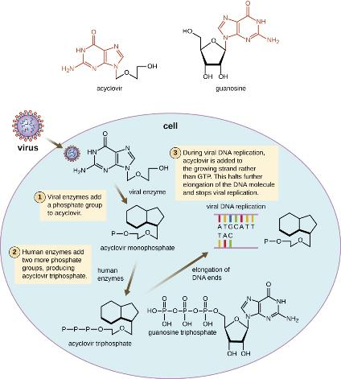
Figure 14.16
Acyclovir is a structural analog of guanosine. It is specifically activated by the viral enzyme thymidine kinase and then preferentially binds to viral DNA polymerase, leading to chain termination during DNA replication.

Slide 18
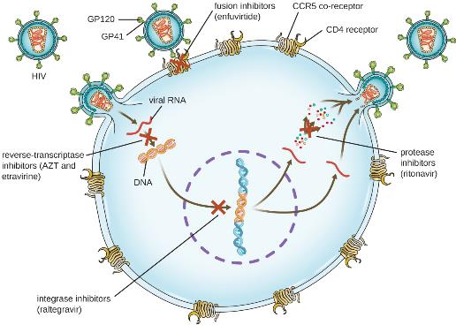
Figure 14.17
Antiretroviral therapy (ART) is typically used for the treatment of HIV. The targets of drug classes currently in use are shown here. (credit: modification of work by Thomas Splettstoesser)

Slide 19
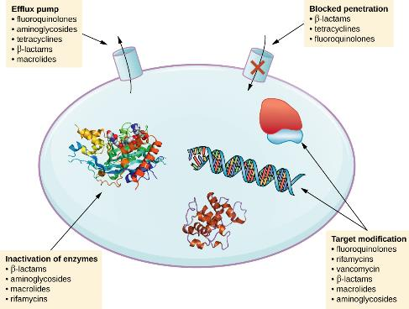
Figure 14.18
There are multiple strategies that microbes use to develop resistance to antimicrobial drugs. (Not shown: target overproduction, target mimicry, and enzymatic bypass). (credit: modification of work by Gerard D Wright)

Slide 20
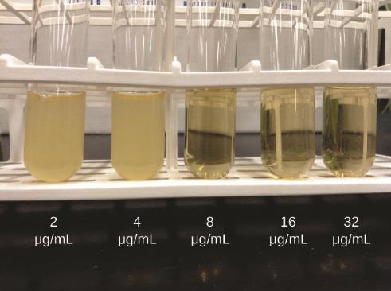
Figure 14.19
In a dilution test, the lowest dilution that inhibits turbidity (cloudiness) is the MIC. In this example, the MIC is 8 μg/mL. Broth from samples without turbidity can be inoculated onto plates lacking the antimicrobial drug. The lowest dilution that kills ≥99.9% of the starting inoculum is observed on the plates is the MBC. (credit: modification of work by Suzanne Wakim)

Slide 21
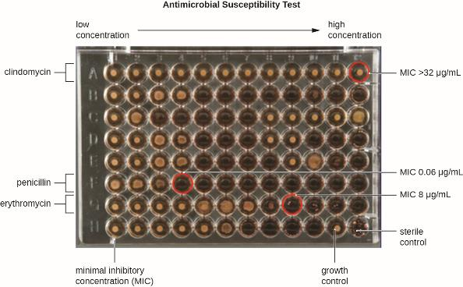
Figure 14.20
A microdilution tray can also be used to determine MICs of multiple antimicrobial drugs in a single assay. In this example, the drug concentrations increase from left to right and the rows with clindamycin, penicillin, and erythromycin have been indicated to the left of the plate. For penicillin and erythromycin, the lowest concentrations that inhibited visible growth are indicated by red circles and were 0.06 μg/mL for penicillin and 8 μg/mL for erythromycin. For clindamycin, visible bacterial growth was observed at every concentration up to 32 μg/mL and the MIC is interpreted as >32 μg/mL. (credit: modification of work by Centers for Disease Control and Prevention)

Slide 22
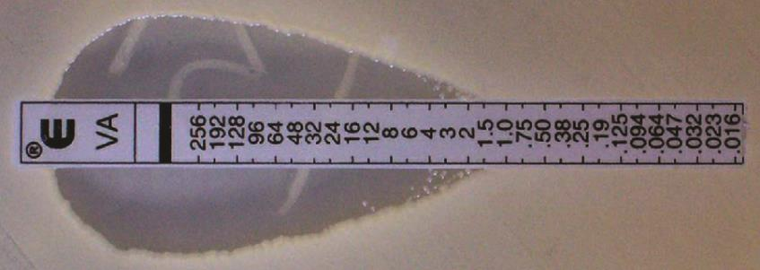
Figure 14.21
The Etest can be used to determine the MIC of an antibiotic. In this Etest, vancomycin is shown to have a MIC of 1.5 μg/mL against Staphylococcus aureus.

Slide 23
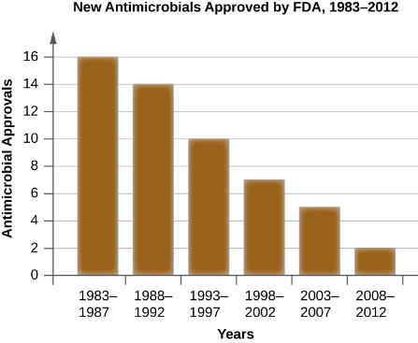
Figure 14.22
In recent decades, approvals of new antimicrobials by the FDA have steadily fallen. In the five-year period from 1983–1987, 16 new antimicrobial drugs were approved, compared to just two from 2008–2012.

Slide 24
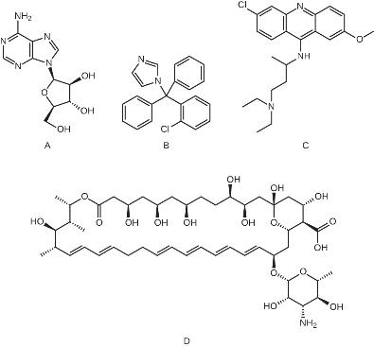
EXERCISE 49

Slide 25
This file is copyright 2016, Rice University. All Rights Reserved.

