Slide 1
microbiology
Chapter 8 Microbial metabolism

Slide 2
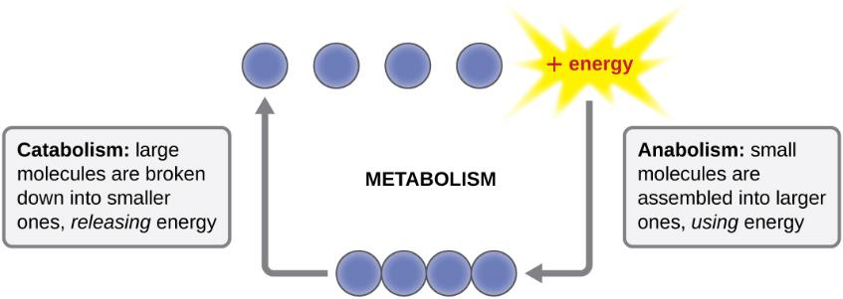
Figure 8.2
Metabolism includes catabolism and anabolism. Anabolic pathways require energy to synthesize larger molecules. Catabolic pathways generate energy by breaking down larger molecules. Both types of pathways are required for maintaining the cell’s energy balance.

Slide 3
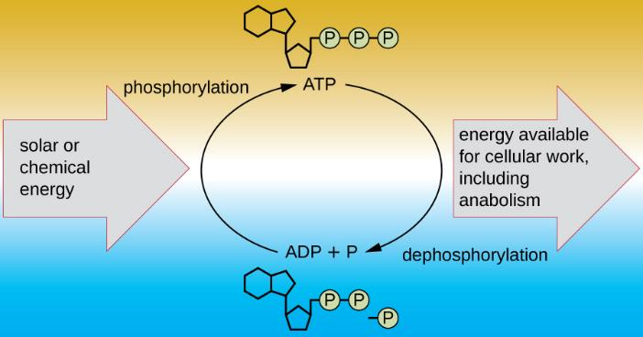
Figure 8.3
The energy released from dephosphorylation of ATP is used to drive cellular work, including anabolic pathways. ATP is regenerated through phosphorylation, harnessing the energy found in chemicals or from sunlight. (credit: modification of work by Robert Bear, David Rintoul)

Slide 4
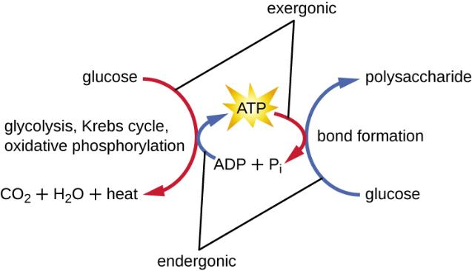
Figure 8.4
Exergonic reactions are coupled to endergonic ones, making the combination favorable. Here, the endergonic reaction of ATP phosphorylation is coupled to the exergonic reactions of catabolism. Similarly, the exergonic reaction of ATP dephosphorylation is coupled to the endergonic reaction of polypeptide formation, an example of anabolism.

Slide 5
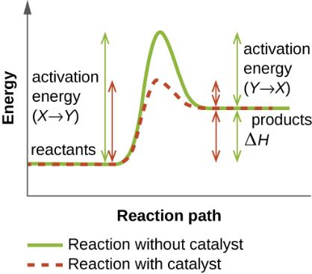
Figure 8.5
Enzymes lower the activation energy of a chemical reaction.

Slide 6
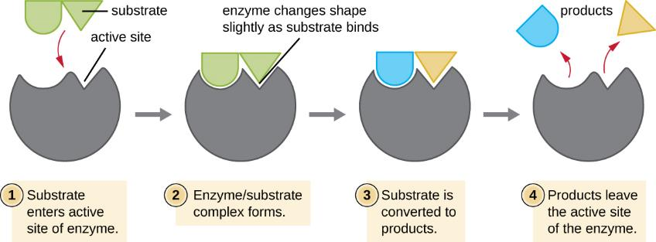
Figure 8.6
According to the induced-fit model, the active site of the enzyme undergoes conformational changes upon binding with the substrate.

Slide 7
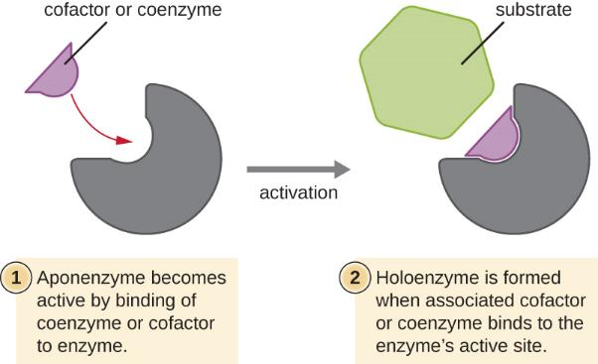
Figure 8.7
The binding of a coenzyme or cofactor to an apoenzyme is often required to form an active holoenzyme.

Slide 8
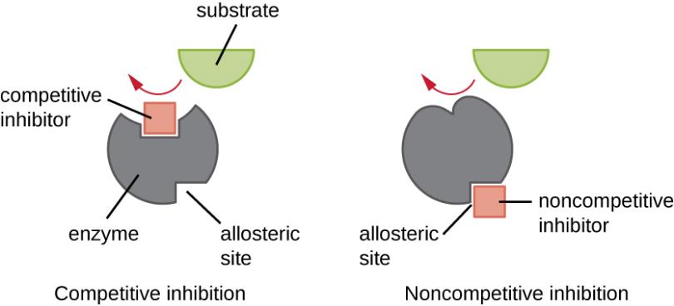
Figure 8.8
Enzyme activity can be regulated by either competitive inhibitors, which bind to the active site, or noncompetitive inhibitors, which bind to an allosteric site.

Slide 9
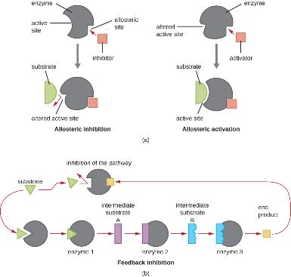
Figure 8.9
Binding of an allosteric inhibitor reduces enzyme activity, but binding of an allosteric activator increases enzyme activity.
Feedback inhibition, where the end product of the pathway serves as a noncompetitive inhibitor to an enzyme early in the pathway, is an important mechanism of allosteric regulation in cells.

Slide 10
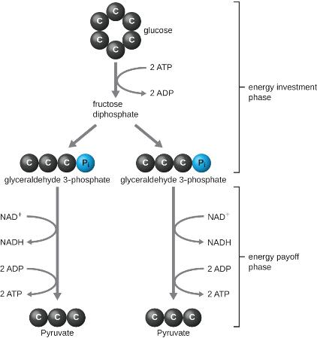
Figure 8.10
The energy investment phase of the Embden-Meyerhof-Parnas glycolysis pathway uses two ATP molecules to phosphorylate glucose, forming two glyceraldehyde 3-phosphate (G3P) molecules. The energy payoff phase harnesses the energy in the G3P molecules, producing four ATP molecules, two NADH molecules, and two pyruvates.

Slide 11
Figure 8.11
The ATP made during glycolysis is a result of substrate-level phosphorylation. One of the two enzymatic reactions in the energy payoff phase of Embden Meyerhof-Parnas glycolysis that produce ATP in this way is shown here.

Slide 12
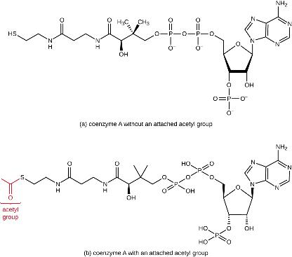
Figure 8.12
Coenzyme A is shown here without an attached acetyl group.
Coenzyme A is shown here with an attached acetyl group.

Slide 13
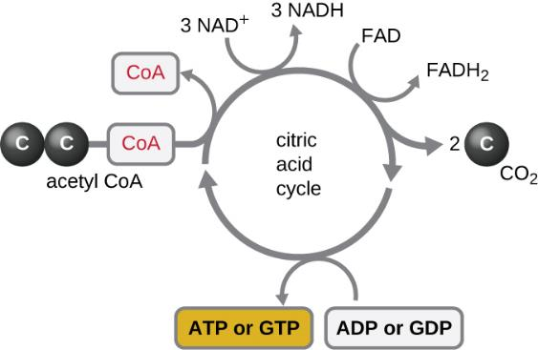
Figure 8.13
The Krebs cycle, also known as the citric acid cycle, is summarized here. Note incoming two-carbon acetyl results in the main outputs per turn of two CO₂, three NADH, one FADH₂, and one ATP (or GTP) molecules made by substrate-level phosphorylation. Two turns of the Krebs cycle are required to process all of the carbon from one glucose molecule.

Slide 14
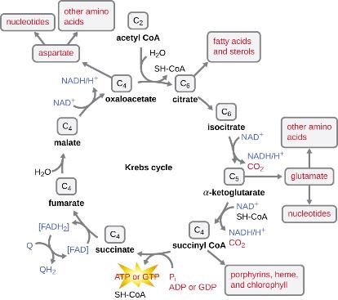
Figure 8.14
Many organisms use intermediates from the Krebs cycle, such as amino acids, fatty acids, and nucleotides, as building blocks for biosynthesis.

Slide 15
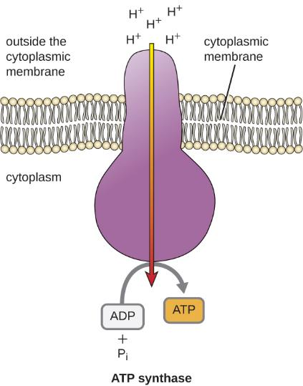
Figure 8.15
ATP synthase is a complex integral membrane protein through which H⁺ flows down an electrochemical gradient, providing the energy for ATP production by oxidative phosphorylation. (credit: modification of work by Klaus Hoffmeier)

Slide 16
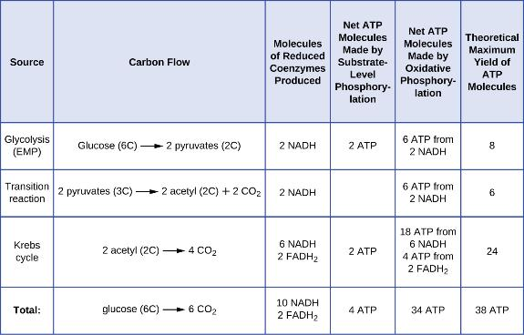
Figure 8.16

Slide 17
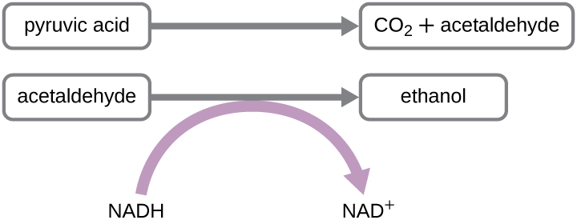
Figure 8.17
The chemical reactions of alcohol fermentation are shown here. Ethanol fermentation is important in the production of alcoholic beverages and bread.

Slide 18
Figure 8.18
The API 20NE test strip is used to identify specific strains of gram-negative bacteria outside the Enterobacteriaceae. Here is an API 20NE test strip result for Photobacterium damselae ssp. piscicida.

