Slide 1
microbiology
Chapter s 3.3–3.4, 4.2-4.4, 4.6

Slide 2
Figure 3.1
Foundations of Modern Cell Theory
Microorganisms vary visually in their size and shape, as can be observed microscopically; but they also vary in invisible ways, such as in their metabolic capabilities. (credit a, e, f: modification of work by Centers for Disease Control and Prevention; credit b: modification of work by NIAID; credit c: modification of work by CSIRO; credit d: modification of work by “Microscopic World”/YouTube)

Slide 3
Figure 3.4
Louis Pasteur
French scientist Louis Pasteur, who definitively refuted the long-disputed theory of spontaneous generation.
The unique swan-neck feature of the flasks used in Pasteur’s experiment allowed air to enter the flask but prevented the entry of bacterial and fungal spores.
Pasteur’s experiment consisted of two parts. In the first part, the broth in the flask was boiled to sterilize it. When this broth was cooled, it remained free of contamination. In the second part of the experiment, the flask was boiled and then the neck was broken off. The broth in this flask became contaminated. (credit b: modification of work by “Wellcome Images”/Wikimedia Commons)

Slide 4
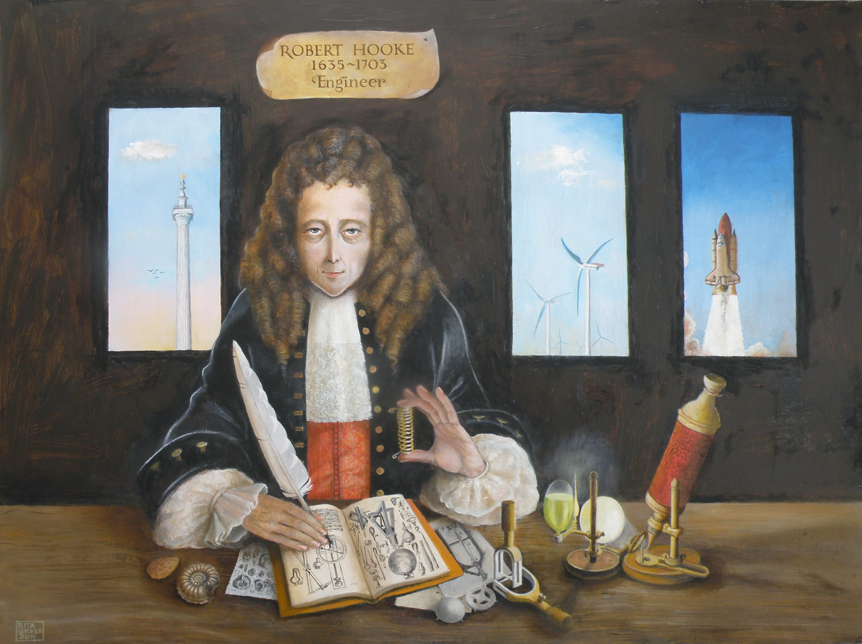
Figure 3.5
Robert Hooke
Robert Hooke (1635–1703) was the first to describe cells based upon his microscopic observations of cork. This illustration was published in his work Micrographia.

Slide 5
Figure 3.6
Rudolf Virchow (1821–1902) popularized the cell theory in an 1855 essay entitled “Cellular Pathology.”
The idea that all cells originate from other cells was first published in 1852 by his contemporary and former colleague Robert Remak (1815–1865).

Slide 6
Figure 3.7
THE ENDOSYMBIOTIC tHEORY
According to the endosymbiotic theory, mitochondria and chloroplasts are each derived from the uptake of bacteria. These bacteria established a symbiotic relationship with their host cell that eventually led to the bacteria evolving into mitochondria and chloroplasts.

Slide 7
Figure 3.8
The Germ Theory of Disease
Ignaz Semmelweis (1818–1865) was a proponent of the importance of handwashing to prevent transfer of disease between patients by physicians.

Slide 8
Figure 3.9
The Germ Theory of Disease
Joseph Lister developed procedures for the proper care of surgical wounds and the sterilization of surgical equipment.
Robert Koch established a protocol to determine the cause of infectious disease. Both scientists contributed significantly to the acceptance of the germ theory of disease.

Slide 9
Figure 3.11
(credit “swan-neck flask”: modification of work by Wellcome Images)
Notes:
The wacky history of cell theory - Lauren Royal-Woods https://www.youtube.com/watch?v=4OpBylwH9DU

Slide 10
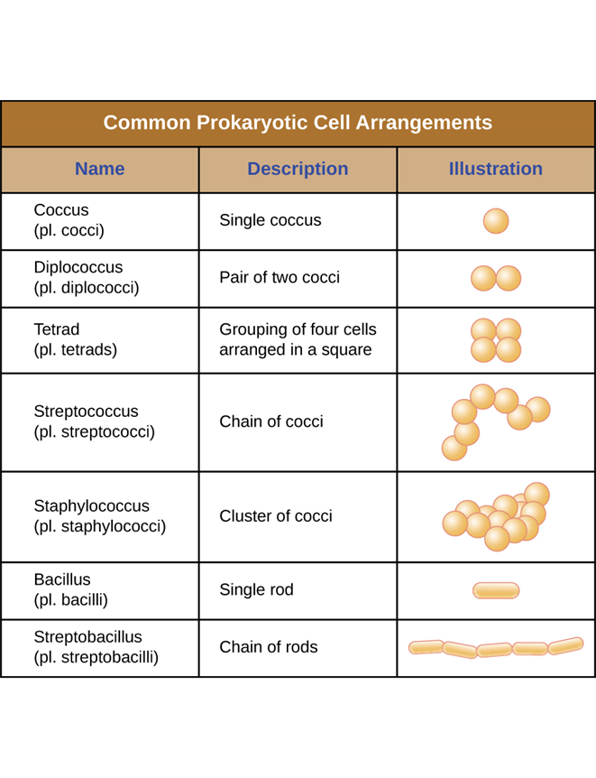
Figure 3.13
Cell Morphologies and Arrangements

Slide 11
Figure 3.15
CELL tonicity
In cells that lack a cell wall, changes in osmotic pressure can lead to crenation (shriveling of the cell) in hypertonic environments or cell lysis in hypotonic environments.

Slide 12
Figure 3.16
osmotic pressure
In prokaryotic cells, the cell wall provides some protection against changes in osmotic pressure, allowing it to maintain its shape longer. The cell membrane is typically attached to the cell wall in an isotonic medium (left). In a hypertonic medium, the cell membrane detaches from the cell wall and contracts (plasmolysis) as water leaves the cell. In a hypotonic medium (right), the cell wall prevents the cell membrane from expanding to the point of bursting, although lysis will eventually occur if too much water is absorbed.

Slide 13
Figure 3.17
The Nucleoid
The nucleoid region (the area enclosed by the green dashed line) is a condensed area of DNA found within prokaryotic cells. Because of the density of the area, it does not readily stain and appears lighter in color when viewed with a transmission electron microscope.

Slide 14
Figure 3.18
ribosomes
Prokaryotic ribosomes (70S) are composed of two subunits: the 30S (small subunit) and the 50S (large subunit), each of which are composed of protein and rRNA components.

Slide 15
Figure 3.19
CELL inclusions
Prokaryotic cells may have various types of inclusions. (a) A transmission electron micrograph of polyhydroxybutryrate lipid droplets. (b) A light micrograph of volutin granules. (c) A phase-contrast micrograph of sulfur granules. (d) A transmission electron micrograph of magnetosomes. (e) A transmission electron micrograph of gas vacuoles. (credit b, c, d: modification of work by American Society for Microbiology)

Slide 16
Figure 3.20
ENDOSPORES
Sporulation begins following asymmetric cell division. The forespore becomes surrounded by a double layer of membrane, a cortex, and a protein spore coat, before being released as a mature endospore upon disintegration of the mother cell.
An electron micrograph of a Carboxydothermus hydrogenoformans endospore.
These Bacillus spp. cells are undergoing sporulation. The endospores have been visualized using Malachite Green spore stain. (credit b: modification of work by Jonathan Eisen)

Slide 17
Figure 3.21
Plasma Membrane
The bacterial plasma membrane is a phospholipid bilayer with a variety of embedded proteins that perform various functions for the cell. Note the presence of glycoproteins and glycolipids, whose carbohydrate components extend out from the surface of the cell. The abundance and arrangement of these proteins and lipids can vary greatly between species.

Slide 18
Figure 3.22
Membrane Transport Mechanisms
Simple diffusion
Simple diffusion down a concentration gradient directly across the phospholipid bilayer. (credit: modification of work by Mariana Ruiz Villareal)

Slide 19
Figure 3.23
Facilitated diffusion
Facilitated diffusion down a concentration gradient through a membrane protein. (credit: modification of work by Mariana Ruiz Villareal)

Slide 20
Figure 3.24
Active transport
Active transport against a concentration gradient via a membrane pump that requires energy. (credit: modification of work by Mariana Ruiz Villareal)

Slide 21
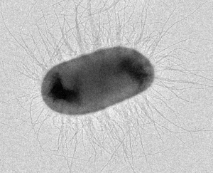
Figure 3.30
Filamentous Appendages
Bacteria may produce two different types of protein appendages that aid in surface attachment. Fimbriae typically are more numerous and shorter, whereas pili (shown here) are longer and less numerous per cell. (credit: modification of work by American Society for Microbiology)
fimbriae

Slide 22
Figure 3.35
3.4 Unique Characteristics of
Eukaryotic Cells
An illustration of a generalized, single-celled eukaryotic organism. Note that cells of eukaryotic organisms vary greatly in terms of structure and function, and a particular cell may not have all of the structures shown here.

Slide 23
nucleus
Figure 3.37
Eukaryotic cells have a well-defined nucleus. The nucleus of this mammalian lung cell is the large, dark, oval-shaped structure in the lower half of the image.

Slide 24
RER and SER
Figure 3.40
The endomembrane system is composed of a series of membranous intracellular structures that facilitate movement of materials throughout the cell and to the cell membrane.

Slide 25
Golgi apparatus
Figure 3.42
A transmission electron micrograph (left) of a Golgi apparatus in a white blood cell. The illustration (right) shows the cup-shaped, stacked disks and several transport vesicles. The Golgi apparatus modifies lipids and proteins, producing glycolipids and glycoproteins, respectively, which are commonly inserted into the plasma membrane.

Slide 26
peroxisome
Figure 3.43
A transmission electron micrograph (left) of a cell containing a peroxisome. The illustration (right) shows the location of peroxisomes in a cell. These eukaryotic structures play a role in lipid biosynthesis and breaking down various molecules. They may also have other specialized functions depending on the cell type. (credit “micrograph”: modification of work by American Society for Microbiology)

Slide 27
mitochondria
Figure 3.49
Each mitochondrion is surrounded by two membranes, the inner of which is extensively folded into cristae and is the site of the intermembrane space. The mitochondrial matrix contains the mitochondrial DNA, ribosomes, and metabolic enzymes. The transmission electron micrograph of a mitochondrion, on the right, shows both membranes, including cristae and the mitochondrial matrix. (credit “micrograph”: modification of work by Matthew Britton; scale-bar data from Matt Russell)

Slide 28
Figure 3.51
The eukaryotic plasma membrane is composed of a lipid bilayer with many embedded or associated proteins. It contains cholesterol for the maintenance of membrane, as well as glycoproteins and glycolipids that are important in the recognition other cells or pathogens.

Slide 29
endocytosis
Figure 3.52
Three variations of endocytosis are shown. (a) In phagocytosis, the cell membrane surrounds the particle and pinches off to form an intracellular vacuole. (b) In pinocytosis, the cell membrane surrounds a small volume of fluid and pinches off, forming a vesicle. (c) In receptor-mediated endocytosis, the uptake of substances is targeted to a specific substance (a ligand) that binds at the receptor on the external cell membrane. (credit: modification of work by Mariana Ruiz Villarreal)

Slide 30
Figure 3.53
The extracellular matrix is composed of protein and carbohydrate components. It protects cells from physical stresses and transmits signals arriving at the outside edges of the tissue to cells deeper within the tissue.
Notes:
Prokaryotes and Eukaryotes https://www.youtube.com/watch?v=RQ-SMCmWB1s

Slide 31
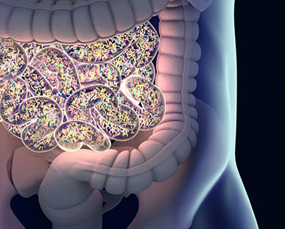
Prokaryotic diversity
CH 4.1-4.4, 4.6
Prokaryotes are ubiquitous. They can be found everywhere on our planet, even in hot springs, in the Antarctic ice shield, and under extreme pressure two miles under water.
Prokaryotes also are abundant on and within the human body. According to a report by National Institutes of Health, prokaryotes, especially bacteria, outnumber human cells 10:1.

Slide 32
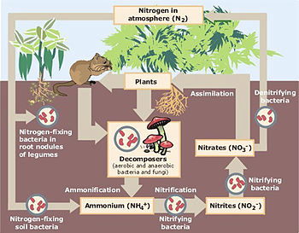
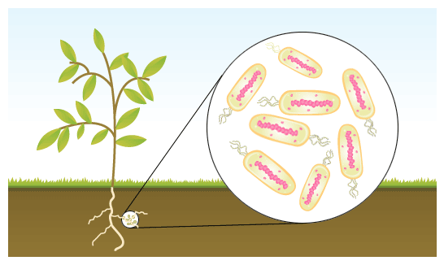
Prokaryotic diversity (con’t)
The existence of prokaryotes is very important for the stability and thriving of ecosystems because they:
- are a necessary part of soil formation and stabilization processes through the breakdown of organic matter and development of biofilms.
- perform functions vital to life on earth by capturing (or “fixing”) and recycling elements like carbon and nitrogen.
- clean up the environment.
< 1% of prokaryotes (all of them bacteria) are thought to be human pathogens. Some bacteria can contaminate food, causing spoilage or foodborne illness, which makes them subjects of concern in food preparation and safety.

Slide 33
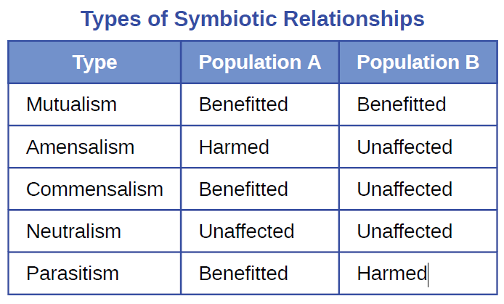
Symbiotic Relationships
Prokaryotes live in a community, or a group of interacting populations of organisms.
Population is a group of individual organisms belonging to the same biological species and limited to a certain geographic area.
Populations can have cooperative interactions, which benefit the populations, or competitive interactions, in which one population competes with another for resources. The study of these interactions between populations is called microbial ecology.
Any interaction between different species
within a community is called symbiosis.
Such interactions fall along a continuum
between opposition and cooperation.
Interactions in a symbiotic relationship may be
beneficial or harmful, or have no effect on one
or both of the species involved.

Slide 34
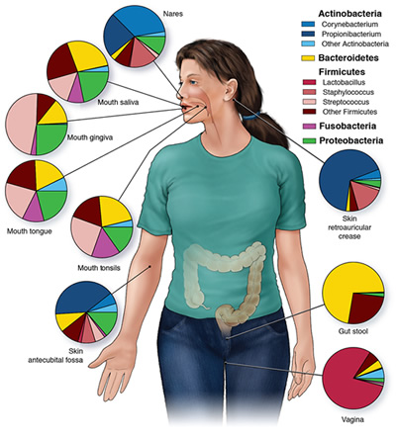
Microbiome
Microbiome - all prokaryotic and eukaryotic microorganisms that are associated with a certain organism. Within the human microbiome, there are resident microbiota and transient microbiota.
The resident microbiota consists of microorganisms that constantly live in or on our bodies.
The resident microbiota is diverse in terms of
the variety of species and in terms of the
preference of different microorganisms for
different areas of the human body.
Microbiome can also change over time
within the same individual.
The term transient microbiota refers to
microorganisms that are only temporarily found in the human body, and these may include pathogenic microorganisms.
Hygiene and diet can alter both the resident
and transient microbiota.

