Slide 1
microbiology
CH 1.1-1.3, 2.4

Slide 2
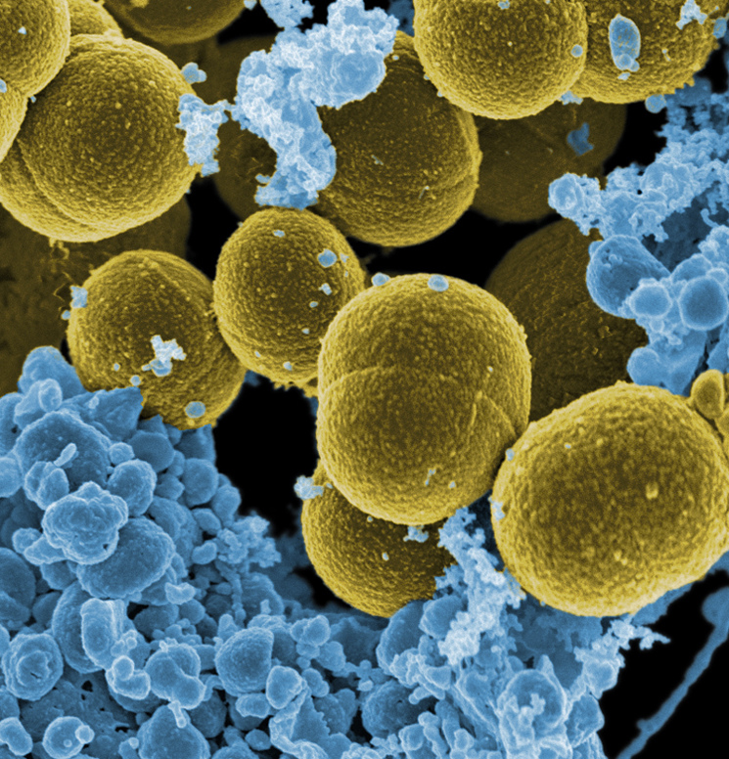
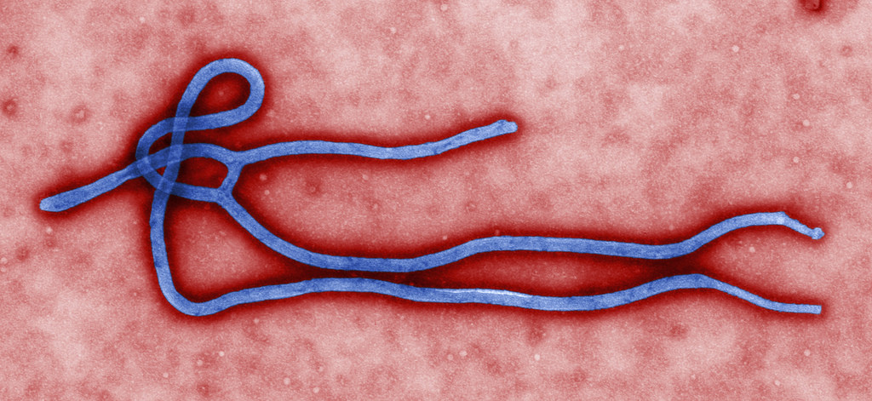
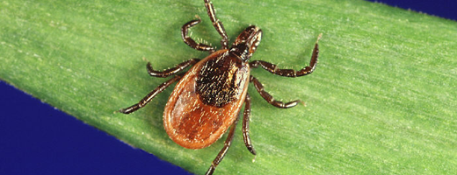
The Main Themes of Microbiology
Microbiology: the specialized area of biology that deals with organisms too small to be seen with the naked eye.
Microorganisms or microbes
Germs, viruses, or agents
“Bugs”
Staphylococcus aureus
(en.wikipedia.org)
Ebola virus
(CDC.gov)
Deer tick, vector for Lyme disease , causative agent Borrelia burgdorferi
(www.healthycanadians.gc.ca)
Notes:
Such microscopic organisms are collectively referred to as microorganisms (my′′- kroh-or′-gun-izms), microbes, or several other terms depending on the kind of microbe or the purpose. In the context of infection and disease, some people call them germs, viruses, or agents; others even call them “bugs”; but none of these terms are clear.

Slide 3
Major groups of microorganisms (in order of decreasing complexity):
Eukaryotes (true nucleus) - cells contain a nucleus and organelles enclosed within membranes.
Arthropods (ex. Mosquito) – vectors (transmit infectious agent from one host to another)
Helminths – all parasitic worms, one or more organ systems (primitive nervous system, muscles, reproductive system), life cycle is complex. Ex. Nematoda (round worm), Cestoda/Taenia (tape worm)
Algae (ex. Diatoms, Dinoflagellates) – aquatic eukaryotes (cause intoxication such as paralytic shellfish poisoning)
Fungi (ex. Microsporum – foot fungus) – saprophytic (eat “dead” material), samples identified by reproductive structures.
Protozoa (ex. Giardia, Vortecella) – single cells, mostly aquatic identified by motility (flagella, cilia, amoeboid movements)
Notes:
There are several major groups of microorganisms that we’ll be studying.
Certain invertebrate animals—such as helminths (worms), many of which can be seen with the naked eye, are also included in the study of infectious diseases because of the way they are transmitted and the way the body responds to them, though they are not microorganisms.

Slide 4
Prokaryotes (pre nucleus) – lack membranous organelles, 70S ribosomes.
Blue Green Algae ( ex. Cyanobacteria) – O₂ production
most common
types of bacteria
Gram Positive (ex. Staphylococcus) - Gm⁺ appear purple on Gram stain test
Gram Negative (ex. Haemophilus) – Gm⁻ appear red on Gram stain test
Rickettsia, Mycoplasma – obligate intracellular parasites (harder to spread, often require a vector).
Viruses – non-cellular organisms, have protein coat & genetic info (DNA or RNA ~ not both!). Can have envelope, enzymes (for some type of metabolic processes), they lack organelles. Ex: Bacteriophage – infect bacteria, Poxviridae – small pox virus, Picornaviridae – polio virus, also cause common cold.
Prion – protein only (mad cow disease), Viroid –piece of circular single stranded RNA which has some double-stranded regions
Notes:
In general, bacterial and archaeal cells are about 10 times smaller than eukaryotic cells, and they generally lack many of the eukaryotic cell structures such as organelles. Organelles are small, double-membrane-bound structures in the eukaryotic cell that perform specific functions and include the nucleus, mitochondria, and chloroplasts.

Slide 5
Figure 1.3
HUMANS AND MICROORGANISMS
A microscopic view of Saccharomyces cerevisiae, the yeast responsible for making bread rise (left). Yeast is a microorganism. Its cells metabolize the carbohydrates in flour (middle) and produce carbon dioxide, which causes the bread to rise (right). (credit middle: modification of work by Janus Sandsgaard; credit right: modification of work by “MDreibelbis”/Flickr)

Slide 6
Figure 1.4
The Cloaca Maxima, or “Greatest Sewer” (shown in red), ran through ancient Rome. It was an engineering marvel that carried waste away from the city and into the river Tiber.
These ancient latrines emptied into the Cloaca Maxima.

Slide 7
Figure 1.5
Hippocrates, the “father of Western medicine,” believed that diseases had natural, not supernatural, causes.
The historian Thucydides observed that survivors of the Athenian plague were subsequently immune to the infection.
Marcus Terentius Varro proposed that disease could be caused by “certain minute creatures . . . which cannot be seen by the eye.” (credit c: modification of work by Alessandro Antonelli)

Slide 8
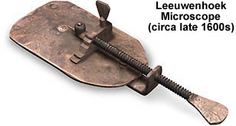
The Birth of Microbiology
Dutch cloth merchant named Antonie Van Leeuwenhoek (1632–1723) was the first to develop a lens powerful enough to view microbes.
In 1675, using a simple but powerful microscope, Leeuwenhoek was able to observe single-celled organisms, which he described as “animalcules” or “wee little beasties,” swimming in a drop of rain water.

Slide 9
Figure 1.6
Louis Pasteur (1822–1895) is credited with numerous innovations that advanced the fields of microbiology and immunology.
Robert Koch (1843–1910) identified the specific microbes that cause anthrax, cholera, and tuberculosis.

Slide 10
Figure 1.7
This Petri dish filled with agar has been streaked with Legionella, the bacterium responsible for causing Legionnaire’s disease.
An inoculation loop like this one can be used to streak bacteria on agar in a Petri dish. (credit a: modification of work by Centers for Disease Control and Prevention; credit b: modification of work by Jeffrey M. Vinocur)

Slide 11
Figure 1.8
The Science of Taxonomy
Swedish botanist, zoologist, and physician Carolus Linnaeus developed a new system for categorizing plants and animals. In this 1853 portrait by Hendrik Hollander, Linnaeus is holding a twinflower, named Linnaea borealis in his honor.

Slide 12
Figure 1.9
Ernst Haeckel’s rendering of the tree of life, from his 1866 book General Morphology of Organisms, contained three kingdoms: Plantae, Protista, and Animalia. He later added a fourth kingdom, Monera, for unicellular organisms lacking a nucleus.

Slide 13
Figure 1.10
This timeline shows how the shape of the tree of life has changed over the centuries. Even today, the taxonomy of living organisms is continually being reevaluated and refined with advances in technology.

Slide 14
Figure 1.11
Woese and Fox’s phylogenetic tree contains three domains: Bacteria, Archaea, and Eukarya. Domains Archaea and Bacteria contain all prokaryotic organisms, and Eukarya contains all eukaryotic organisms. (credit: modification of work by Eric Gaba)

Slide 15
Figure 1.12
Types of Microorganisms
The relative sizes of various microscopic and nonmicroscopic objects. Note that a typical virus measures about 100 nm, 10 times smaller than a typical bacterium (~1 μm), which is at least 10 times smaller than a typical plant or animal cell (~10–100 μm). An object must measure about 100 μm to be visible without a microscope.

Slide 16
Figure 1.13
Prokaryotic Microorganisms
Common bacterial shapes. Note how coccobacillus is a combination of spherical (coccus) and rod-shaped (bacillus). (credit “Coccus”: modification of work by Janice Haney Carr, Centers for Disease Control and Prevention; credit “Coccobacillus”: modification of work by Janice Carr, Centers for Disease Control and Prevention; credit “Spirochete”: Centers for Disease Control and Prevention)

Slide 17
Figure 1.14
Archaea
Some archaea live in extreme environments, such as the Morning Glory pool, a hot spring in Yellowstone National Park. The color differences in the pool result from the different communities of microbes that are able to thrive at various water temperatures.

Slide 18
Figure 1.15
Eukaryotes: Algae
Assorted diatoms, a kind of algae, live in annual sea ice in McMurdo Sound, Antarctica. Diatoms range in size from 2 μm to 200 μm and are visualized here using light microscopy. (credit: modification of work by National Oceanic and Atmospheric Administration)

Slide 19
Figure 1.16
Eukaryotes: Protozoa
Giardia lamblia, an intestinal protozoan parasite that infects humans and other mammals, causing severe diarrhea. (credit: modification of work by Centers for Disease Control and Prevention)

Slide 20
Figure 1.17
Eukaryotes: Fungi
Candida albicans is a unicellular fungus, or yeast. It is the causative agent of vaginal yeast infections as well as oral thrush, a yeast infection of the mouth that commonly afflicts infants. C. albicans has a morphology similar to that of coccus bacteria; however, yeast is a eukaryotic organism (note the nuclei) and is much larger. (credit: modification of work by Centers for Disease Control and Prevention)

Slide 21
Figure 1.18
Eukaryotes: Fungi
Large colonies of microscopic fungi can often be observed with the naked eye, as seen on the surface of these moldy oranges.

Slide 22
Figure 1.19
Eukaryotes: Helminths
The beef tapeworm, Taenia saginata, infects both cattle and humans. T. saginata eggs are microscopic (around 50 μm), but adult worms like the one shown here can reach 4–10 m, taking up residence in the digestive system.
An adult guinea worm, Dracunculus medinensis, is removed through a lesion in the patient’s skin by winding it around a matchstick. (credit a, b: modification of work by Centers for Disease Control and Prevention)

Slide 23
Figure 1.20
Viruses
Members of the Coronavirus family can cause respiratory infections like the common cold, severe acute respiratory syndrome (SARS), and Middle East respiratory syndrome (MERS). Here they are viewed under a transmission electron microscope (TEM).
Ebolavirus, a member of the Filovirus family, as visualized using a TEM. (credit a: modification of work by Centers for Disease Control and Prevention; credit b: modification of work by Thomas W. Geisbert)

Slide 24
Figure 1.21
Microbiology as a Field of Study
A virologist samples eggs from this nest to be tested for the influenza A virus, which causes avian flu in birds. (credit: U.S. Fish and Wildlife Service)

Slide 25
Medical Microbiology
is the study of the pathogenic microbes and the role of microbes in human illness.
This includes the study of microbial pathogenesis and epidemiology and is related to the study of disease pathology and immunology.
Boundless Microbiology at http://bit.ly/2fNg8H6 /

Slide 26
Pharmaceutical Microbiology
The study of microorganisms that are related to the production of antibiotics, enzymes, vitamins, vaccines, and other pharmaceutical products. Pharmaceutical microbiology also studies the causes of pharmaceutical contamination and spoil.
Boundless Microbiology at http://bit.ly/2fNg8H6 /

Slide 27
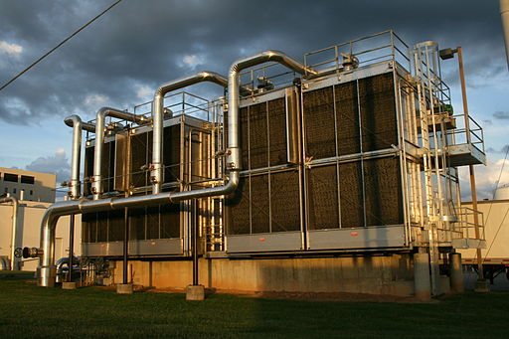
Industrial Microbiology
The exploitation of microbes for use in industrial processes.
Examples include industrial fermentation and waste-water treatment.
Boundless Microbiology at http://bit.ly/2fNg8H6 /

Slide 28
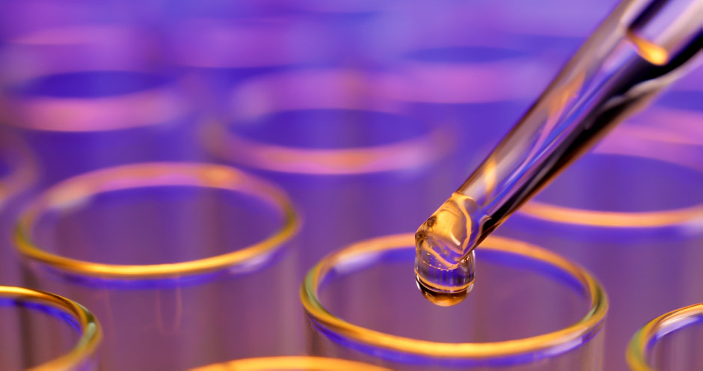
Microbial Biotechnology
The manipulation of microorganisms at the genetic and molecular level to generate useful products.
Boundless Microbiology at http://bit.ly/2fNg8H6 /

Slide 29
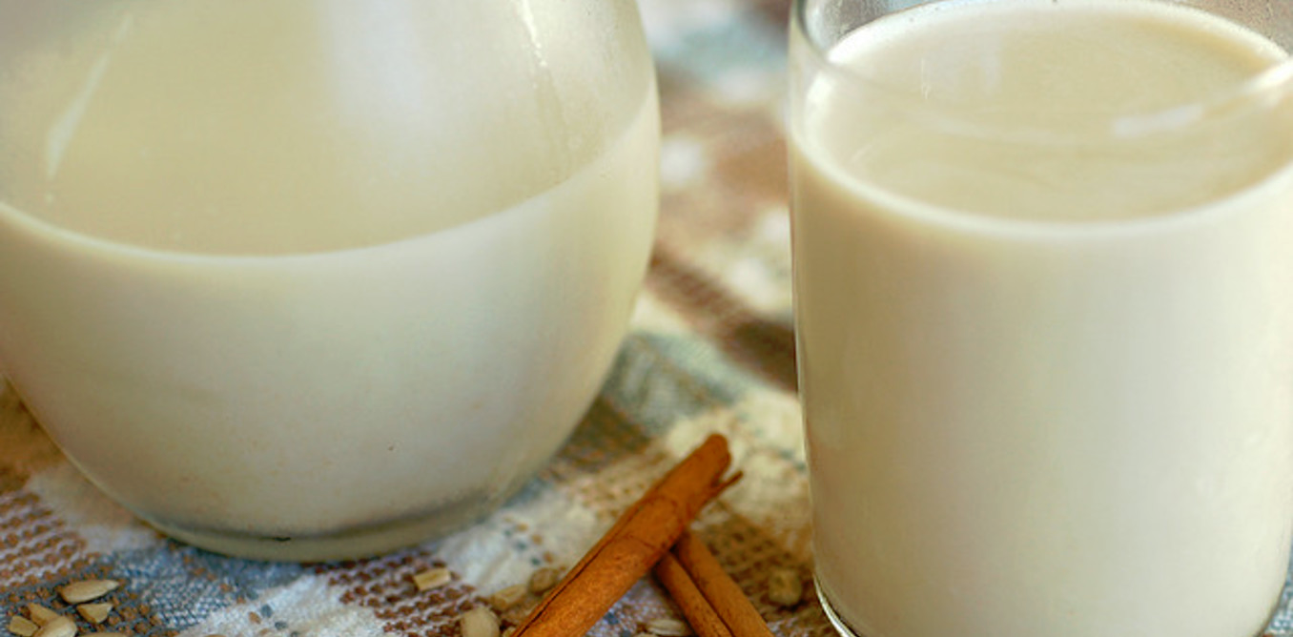
Food Microbiology and Dairy Microbiology
The study of microorganisms causing food spoilage and food-borne illness.
Microorganisms can produce foods, for example by fermentation.
Boundless Microbiology at http://bit.ly/2fNg8H6 /

Slide 30
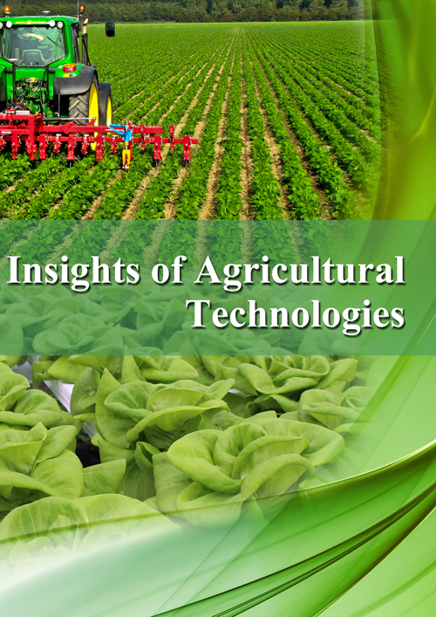
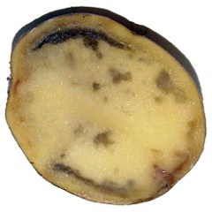
Agricultural Microbiology
The study of agriculturally relevant microorganisms. This field can be further classified into the following subfields:
Plant microbiology and plant pathology
Soil microbiology
Veterinary microbiology
Environmental microbiology
Boundless Microbiology at http://bit.ly/2fNg8H6 /

Slide 31
Bioremediation
Bioremediation:
Introduction of microbes
into the environment to
restore stability or to clean
up toxic pollutants

Slide 32
Preparing Specimens for Light Microscopy
In clinical settings, light microscopes are the most commonly used microscopes. There are two basic types of preparation used to view specimens with a light microscope:
wet mounts
fixed specimens
The simplest type of preparation is the wet mount, in which the specimen is placed on the slide in a drop of liquid.
Once the
liquid has been added to the slide, a coverslip is placed on top and the specimen is ready for examination under the
microscope.

Slide 33
Preparing Specimens for Light Microscopy
The second method of preparing specimens for light microscopy is fixation. The “fixing” of a sample refers to the process of attaching cells to a slide. Fixation is often achieved either by heating (heat fixing - a, b above) or chemically treating the specimen (c). In addition to attaching the specimen to the slide, fixation also kills microorganisms in the specimen, stopping their movement and metabolism while preserving the integrity of their cellular components for observation.

Slide 34
Figure 2.32
Staining techniques
Dyes are selected for staining based on the chemical properties of the
dye and the specimen being observed:
Positive stain - absorbed by the cells or organisms being observed, adding color to objects of interest to make them stand out against the background (fig. a, b).
Negative stain - absorbed by the background but not by the cells in the specimen. Negative staining produces an outline or silhouette of the organisms against a colorful background (fig. c).
These Bacillus anthracis cells have absorbed crystal violet, a basic positive stain.
This specimen of Spinoloricus, a microscopic marine organism, has been stained with rose bengal, a positive acidic stain.
These B. megaterium appear to be white because they have not absorbed the negative red stain applied to the slide. (credit a: modification of work by Centers for Disease Control and Prevention; credit b: modification of work by Roberto Danovaro, Antonio Pusceddu, Cristina Gambi, Iben Heiner, Reinhardt Mobjerg Kristensen; credit c: modification of work by Anh-Hue Tu)

Slide 35
Figure 2.33
Gram Staining
Gram-staining is a differential staining technique that uses a primary stain and a secondary counterstain to distinguish between gram-positive and gram-negative bacteria.

Slide 36
Figure 2.34
In this specimen, the gram-positive bacterium Staphylococcus aureus retains crystal violet dye even after the decolorizing agent is added. Gram-negative Escherichia coli, the most common Gram stain quality-control bacterium, is decolorized, and is only visible after the addition of the pink counterstain safranin. (credit: modification of work by Nina Parker)

Slide 37
Figure 2.36
Acid-Fast Stains
An acid-fast stain is able to differentiate two types of gram-positive cells: those that have waxy mycolic acids in their cell walls, and those that do not. Carbolfuchsin is used as the primary stain. The waxy, acid-fast cells retain the carbolfuchsin
even after a decolorizing agent (an acid-alcohol solution) is applied. A secondary counterstain, methylene blue, is then applied, which renders non–acid-fast cells blue.
Ziehl-Neelsen staining has rendered these Mycobacterium tuberculosis cells red and the surrounding growth indicator medium blue. (credit: modification of work by American Society for Microbiology)

Slide 38
Figure 2.37
Capsule Staining
Negative staining technique (staining around the cells) is typically used for
capsule staining (capsules do not absorb most basic dyes). The dye stains the background but does not penetrate the capsules, which appear like halos around the borders of the cell.
The specimen does not need to be heat-fixed prior to negative staining.
India-ink was used to stain the background around these cells of the yeast Cryptococcus neoformans. The halos surrounding the cells are the polysaccharide capsules.
Crystal violet and copper sulfate dyes cannot penetrate the encapsulated Bacillus cells in this negatively stained sample. Encapsulated cells appear to have a light-blue halo. (credit a: modification of work by American Society for Microbiology; credit b: modification of work by American Society for Microbiology)

Slide 39
Figure 2.38
Endospore Staining
Uses two stains to differentiate endospores from the rest of the cell:
The Schaeffer-Fulton method uses heat to push the primary stain (malachite green) into the endospore. Washing with water decolorizes the cell, but the endospore retains the green stain.
The cell is then counterstained pink with safranin. The resulting image reveals the shape and location of endospores, if they are present.
A stained preparation of Bacillus subtilis showing endospores (structures produced within certain bacterial cells that allow them to survive harsh conditions) as green and the vegetative cells as pink. (credit: modification of work by American Society for Microbiology)

Slide 40
Figure 2.39
Flagella Staining
Flagella staining thickens the flagella by first applying mordant (generally tannic acid, but sometimes potassium alum), which coats the flagella; then the specimen is stained with pararosaniline (most commonly) or basic fuchsin
flagella
A flagella stain of Bacillus cereus, a common cause of foodborne illness, reveals that the cells have numerous flagella, used for locomotion. (credit: modification of work by Centers for Disease Control and Prevention)

